Slide 1


Recommendation Engine

Slide 2
Term Project
BDM 3014 – Introduction to Artificial Intelligence
(DSMM Group-1)
Group Members
Kelvin Simon C0866577
Amal V.T C0863255
Henry Jones Inbaraj C0863081
Meenakshi C0864515

Slide 3
Agenda
Introduction
Types of Recommendation Engines
Working process of Recommendation Engine
Math Behind the Recommendation Engine
Recommendation engine using Streamlit app example in python
Conclusion
References

Slide 4
Introduction

Slide 5
Introduction
What Is a Recommendation Engine?
A recommendation engine is a form of data filtering device that uses machine learning algorithms to suggest the products that are most pertinent to a specific user or client.
It works by looking for patterns in data on consumer habits, which may be gathered implicitly or explicitly.
Netflix uses a recommendation engine to offer viewers recommendations for movies and television shows.

Slide 6
Introduction
Contrastingly, Amazon uses a recommendation engine to show customers product suggestions.
While each uses one slightly differently, they both aim to increase sales, increase engagement and customer retention, and provide more individualized customer experiences.
In the past, a salesperson or a person's friends and family would give recommendations. These days, we have given this task over to algorithms, or the minds of algorithms. You could say that these machines are skilled at up-selling and cross-selling as a marketing tool.

Slide 7
Types of Recommendation Engines

Slide 8
Types of Recommendation Engines
Recommendation engines can be divided into three categories:
Collaborative filtering
Content-based filtering
Hybrid model

Slide 9
Types of Recommendation Engines
Collaborative filtering
In order to predict what a person will like based on their similarity to other users, collaborative filtering concentrates on gathering and analyzing data on user behavior, activities, and preferences.
Using a matrix-style formula, collaborative filtering plots and calculates these similarities. Collaborative filtering has the benefit of not needing to understand or analyze the content (products, films, books). It merely chooses items to suggest based on the user's profile.

Slide 10
Types of Recommendation Engines
Content-based filtering
The idea behind content-based filtering is that if you enjoy one item, you'll probably enjoy this other one as well.
In order to generate recommendations, algorithms compare items using cosine and Euclidean distances based on a customer preference profile and a description of the item (genre, product type, colour, word length).
The disadvantage of content-based filtering is that it can only suggest goods or content that are similar to what the user is already using or purchasing.

Slide 11
Types of Recommendation Engines
Content-based filtering
It cannot recommend additional goods or content beyond this. For instance, if the customer had only brought homeware, it was unable to recommend any other items.

Slide 12
Types of Recommendation Engines
Hybrid model
A hybrid recommendation engine examines both the transactional (content-based) data and the meta (collaborative) data. This is why it performs better than both.
A hybrid recommendation engine uses vector equations to determine the degree of similarity between products and can generate natural language processing tags for each product or item (movie, song), as well.

Slide 13
Types of Recommendation Engines
Hybrid model
Using a collaborative filtering matrix, users can then be given recommendations for products based on their actions, pursuits, and preferences.
The ideal illustration of a hybrid recommendation engine is Netflix. It considers both the user's preferences (collaborative) and the details or characteristics of the film or television program (content-based).

Slide 14
Working process of Recommendation Engine

Slide 15
Working process of Recommendation Engine
Data and machine learning technology are combined to operate a recommendation engine.
Data is essential in the creation of a recommendation engine because it serves as the foundation from which patterns can be derived.
It will be more efficient and effective at providing pertinent suggestions for generating revenue the more data it has.
A prevalent four-step process is completed by recommendation engines:

Slide 16
Working process of Recommendation Engine
Step 1 : Data collection
Collecting data is the first and most crucial step in the creation of a recommendation engine.
The two main categories of information to be gathered are:
Implicit Data
This includes data gathered from actions like clicks, cart events, search logs, and order histories on the web.

Slide 17
Working process of Recommendation Engine
Step 1 : Data collection
Explicit Data
This data was compiled using feedback from customers, including reviews, ratings, likes, and dislikes, as well as comments about specific products.
In addition to using feature data (genre, item type) to determine product similarity, recommendation engines also use customer attribute data to identify similar customers, such as demographic (age, gender) and psychographic (interests, values) data.

Slide 18
Working process of Recommendation Engine
Step 2 : Data storage
Data must be stored after it has been collected.
The amount of data will increase dramatically over time. This necessitates the availability of ample, scalable storage.
A variety of storage options are available depending on the type of data you collect.
Step 3 : Data analysis

Slide 19
Working process of Recommendation Engine
The data must then be examined in depth and analyzed in order to be put to use. There are many different approaches to data analysis. These consist of:
Real-time analysis: Data is processed as it is created
Batch analysis: Data is processed periodically
Near-real-time analysis: When data is not required immediately, it is processed in minutes as opposed to seconds.
Step 4 : Data filtering

Slide 20
Working process of Recommendation Engine
The filtering process comes last.
Depending on the type of recommendation filtering being used—collaborative, content-based, or hybrid—different matrices, mathematical rules, and formulas are applied to the data.
The recommendations are the result of this filtering.

Slide 21
Math Behind the Recommendation Engine

Slide 22
Math Behind the Recommendation Engine
Now let us look at the math that works behind the Recommendation Engine.
Let us first look at the collaborative filtering approach
Collaborative Filtering System:
Collaborative filtering systems predict your preferences based on past preferences of users who share your characteristics.
In this strategy, the algorithm goes through the steps as follows:

Slide 23
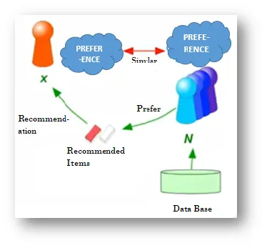
Math Behind the Recommendation Engine
Consider user X
Find set N (Neighborhood of user X) of
Other users whose ratings are “most similar”
To X’s ratings.
Calculate X's ratings based on user feedback
from N.

Slide 24
Math Behind the Recommendation Engine
Measuring the “most similar”
Consider a set of four users (U1, U2, U3, U4) as the table's rows and a set of seven movies (M1, M2...M7) as its columns.
Imagine a scale of 0 to 5 stars.
While some of the cells are empty or lack values, some of the cells contain user ratings for the corresponding movies.

Slide 25
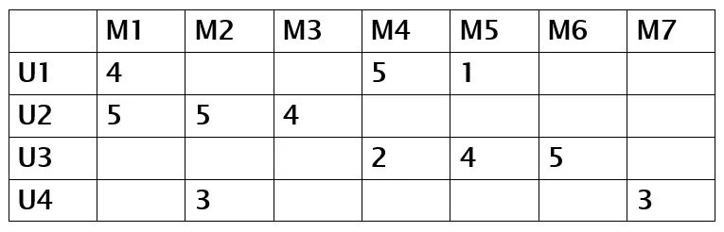
Math Behind the Recommendation Engine
If we carefully examine the above table, we will see that U1 and U2 only have one movie (M1) in common, but their ratings are still quite high.

Slide 26
Math Behind the Recommendation Engine
This suggests a shared set of tastes or interests between users U1 and U2. Although the users U1 and U3 have rated the same two movies, the ratings are not very high. Therefore, we can draw the conclusion that the users U1 and U3 are different, while U1 and U2 are similar.
SIM(U1,U2)>SIM(U1,U3)
We employ the Cosine Similarity to determine the similarity matrix between the two points, U1 and U2:
SIM(U1,U2) = cosine(RU1,RU2),
Where U1 and U2's respective rating vectors, RU1 and RU2, are given.

Slide 27
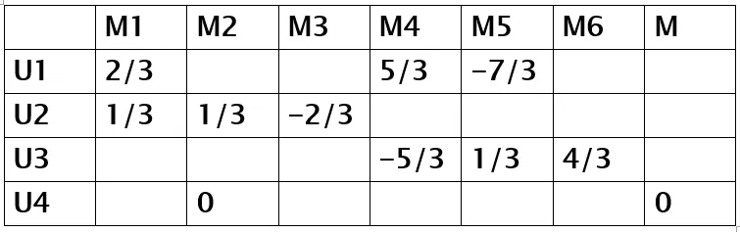
Math Behind the Recommendation Engine
But first we need to compute and fill in the blank values in order to implement the cosine similarity. Therefore, we must normalize the ratings by deducting the row mean and use what is known as the "Centered Cosine Similarity" in place of a cosine similarity.
The table we obtain after normalizing the ratings is shown below:

Slide 28
Math Behind the Recommendation Engine
If you observe, you'll see that adding up all of a user's ratings results in zero. This is due to the ratings' current zero-centering. Ratings above zero denote high or positive ratings, while those below zero denote low or negative ratings. Now, when comparing users U1, U2, and U1, U3, we can calculate their "Centered Cosine Similarity" and find:
SIM (U1, U2) = cosine (RU1, RU2) = 0.09, and
SIM (U1, U3) = cosine (RU1, RU3) = -0.56
SIM (U1, U2) > SIM (U1, U3)

Slide 29
Math Behind the Recommendation Engine
According to the findings, U1 and U2 are very similar, whereas U1 and U3 are very dissimilar.
Making rating predictions for a user is the next step after estimating and grouping similar and dissimilar users.
Rating Predictions:
Let's say that user x has a rating vector Rx, and we need to predict this user's rating for item i.
We identify a neighbourhood N of a set of k users (who have rated item I who are most similar to user x using the Centered Cosine Similarity method.

Slide 30

Math Behind the Recommendation Engine
We use the weighted average to achieve this. In this method, we weight the y rating for item I and multiply it by the similarity of x and y for each user y in neighborhood N.
By dividing the product by the total of the similarities between x and y, we finally normalize it. We receive an estimate for user X and item Y from the outcome.
Where Sxy = SIM(x,y)

Slide 31
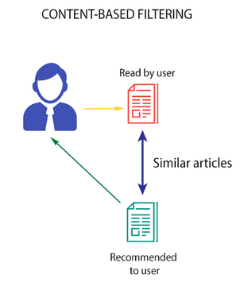
Math Behind the Recommendation Engine
Content based Recommender System:
This algorithm suggests products that are comparable to those that a user has previously liked.
Think about the Netflix illustration. They store all of the user-related data in vector form.
This vector includes the user's previous actions, such as the movies they liked or disliked and the ratings they gave them.
The profile vector is the name given to this vector

Slide 32

Math Behind the Recommendation Engine
Another vector called the item vector contains all the data pertaining to movies.
Each movie's information, such as its genre, cast, and director, is contained in the item vector.
The content-based filtering algorithm finds the cosine of the angle between the profile vector and item vector, i.e. cosine similarity. Suppose A is the profile vector and B is the item vector, then the similarity between them can be calculated as:

Slide 33
Math Behind the Recommendation Engine
The movies are arranged in descending order according to the cosine value, which has a range of -1 to 1, and one of the two methods listed below is used for recommendations:
Top-n approach: where the top n movies are recommended (Here n can be decided by the business)
Rating scale approach: Where a threshold is set and all the movies above that threshold are recommended
Other approaches to trying in similarity include:

Slide 34

Math Behind the Recommendation Engine
Euclidean Distance: When plotted in n-dimensional space, similar objects will be located close to one another. Therefore, we can determine the distance between items and recommend items to the user based on that distance. The following is the euclidean distance formula:
Pearson’s Correlation: We can find out how much two items are correlated using Pearson's correlation. The degree of similarity will increase with the correlation.

Slide 35
Math Behind the Recommendation Engine
Find a set of items liked by the user, by both explicit and implicit methods. For example, the items purchased by the user.
An item profile, which is essentially a description of the items the user purchased, is created using that set of items. For the sake of succinctness, geometric shapes have been used in this diagram. We can therefore conclude that the user prefers objects that are red in colour and have circles or triangles as their primary shapes.
Next, based on the item profile, we will derive a User Profile, which will include details about the user's preferences and purchases.
The following task would be to suggest specific items to the user once we have user and item profiles.

Slide 36
Math Behind the Recommendation Engine
We calculate the degree to which the user and each item in the catalogue are similar given the user. The Cosine Similarity method is used to determine the similarity.
Then, we choose the item that has the greatest cosine similarity and suggest it to the user.

Slide 37


Recommendation engine using Streamlit app example in python

Slide 38
Recommendation engine
This example shows how to develop an easy-to-use book recommendation system.
An algorithm for programming book recommendations is implemented in this code. Based on each book's title and summary, it uses the cosine similarity metric to identify books that are similar to it.
The text data is first preprocessed by the code, which eliminates stopwords, punctuation, and numbers. After that, it uses the TfidfVectorizer to vectorize the cleaned text. Book titles and book descriptions are separated into two separate vectorized text arrays.

Slide 39
Recommendation engine
The Python function used to implement the recommendation system returns a DataFrame with the same feature as the target book as well as the same feature of five additional books that are similar to the target book when given a unique value of a book as input.
The function finds the cosine similarity between the target book vector and all other book vectors, locates the target book by its specific value, removes it from the DataFrame and vectors array.

Slide 40
Recommendation engine
The features of similar books are then determined by index, the cosine similarity coefficients are sorted in descending order, and a DataFrame containing the target book and its five most comparable books is returned.
Streamlit and the scikit-learn library are used to implement a book recommendation system in the code above. It makes use of a dataset of book titles, descriptions, prices, and ratings.
The system asks the user to enter the title of a book they enjoyed, and then uses cosine similarity to suggest other books that are like it.

Slide 41
Recommendation engine
The user can choose from the book's title, rating, or price as the feature to compare with the input book.
To create a matrix of feature vectors for each book, the program tokenizes and purges the text data using the NLTK library and the TfidfVectorizer function from scikit-learn. The cosine similarity between books is determined using these feature vectors.
The user is then shown the suggested books via a Streamlit dataframe.

Slide 42
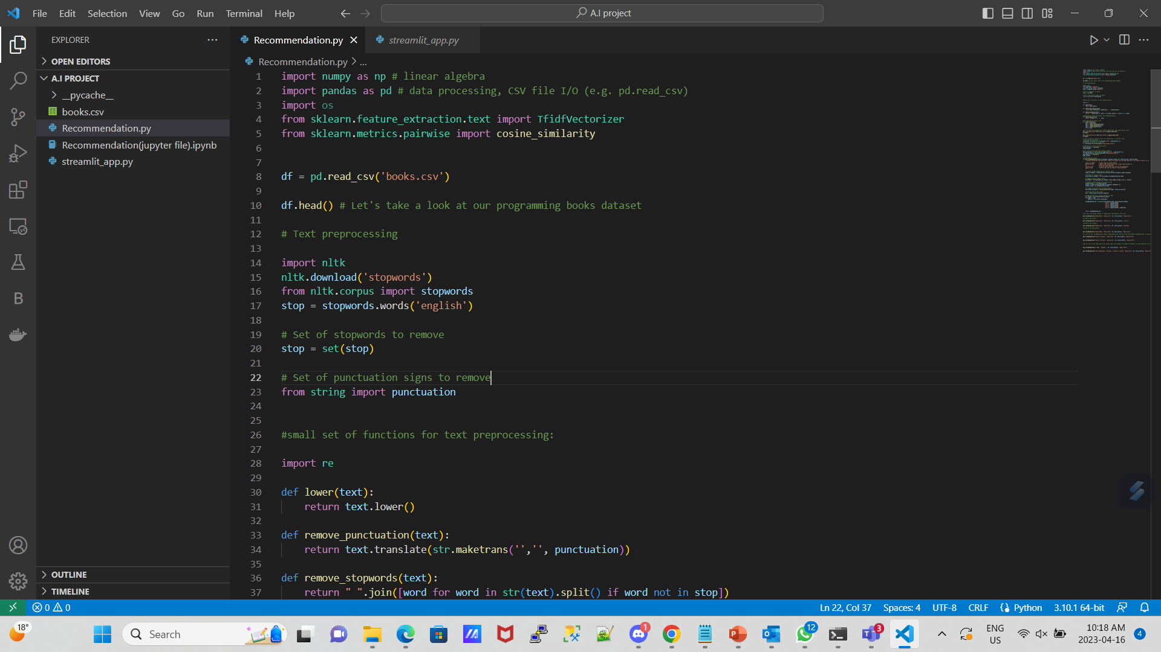
Recommendation engine
‘Recommendation.py’ file containing all necessary code to function the recommendation engine .

Slide 43
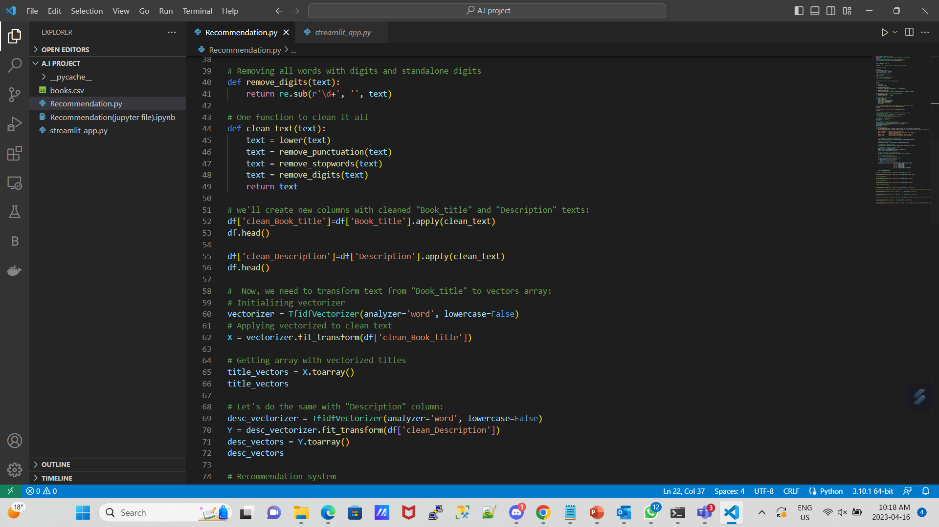
Recommendation engine

Slide 44
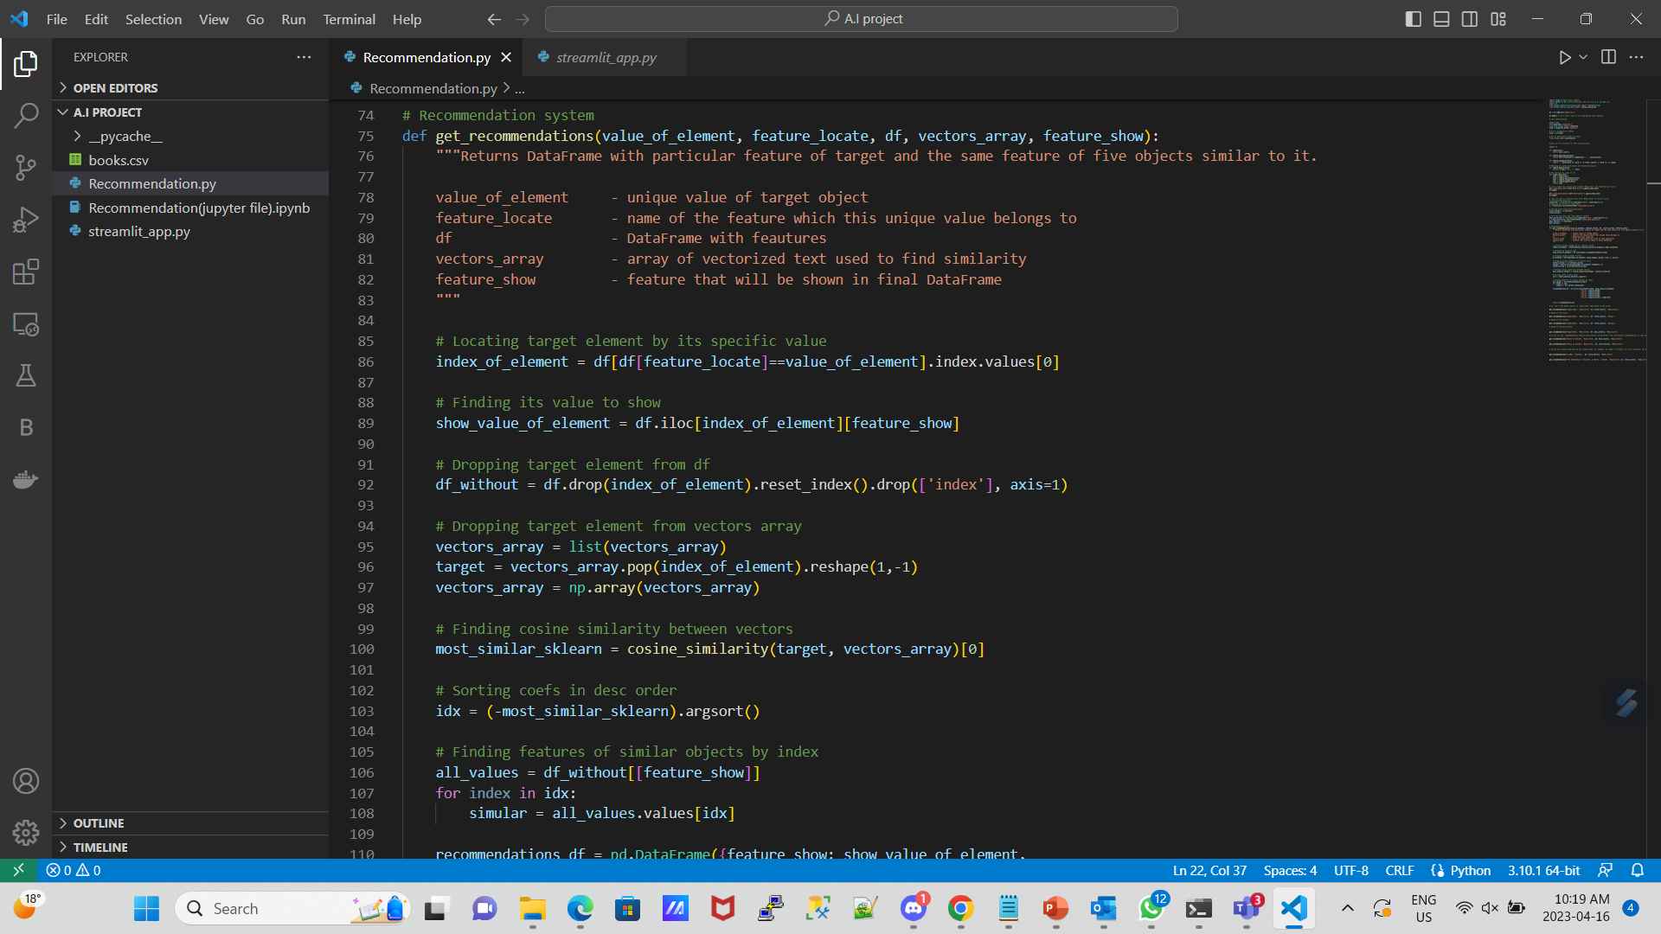
Recommendation engine

Slide 45
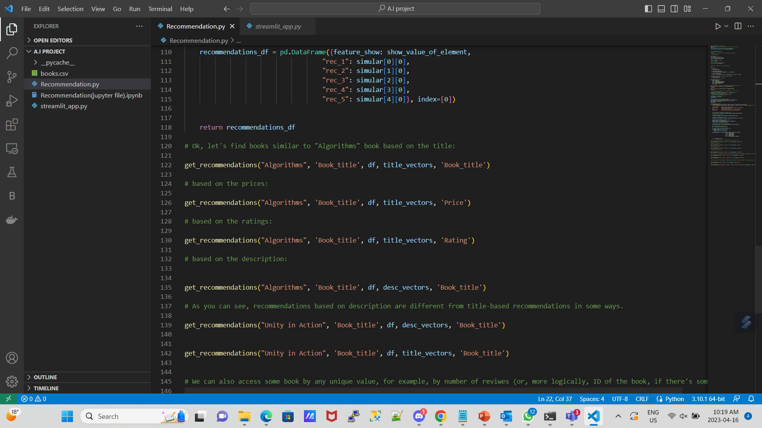
Recommendation engine

Slide 46
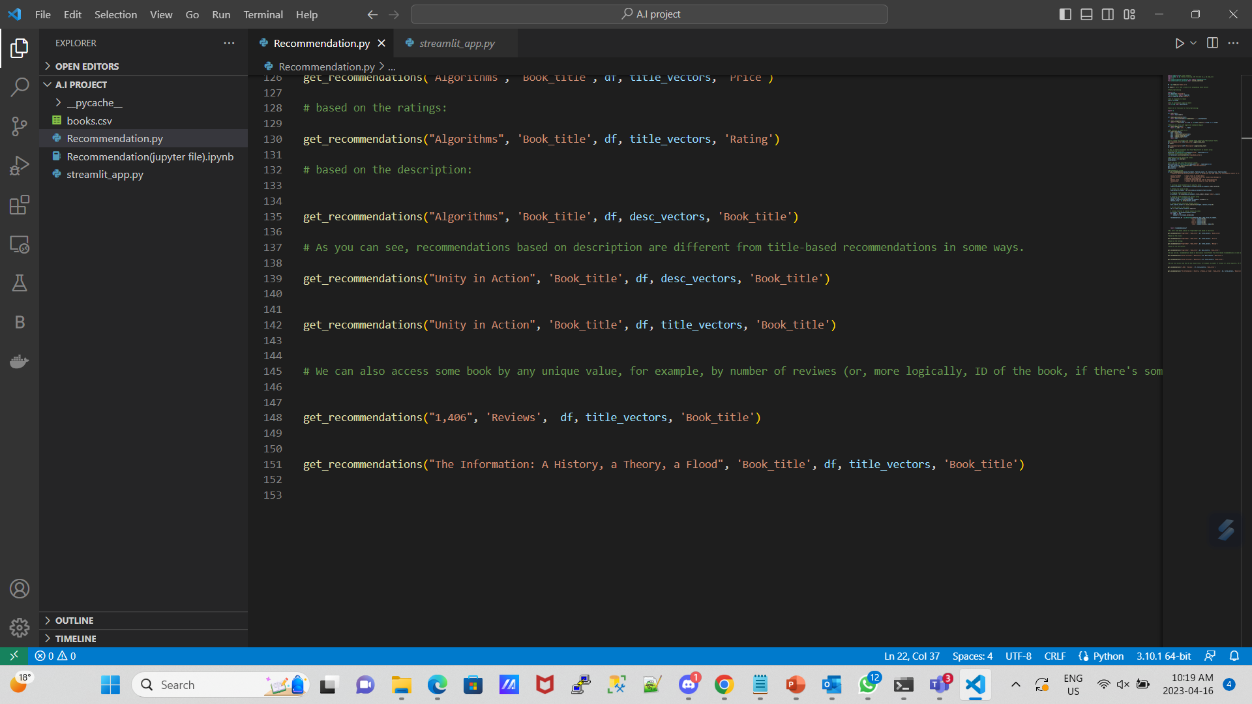
Recommendation engine

Slide 47
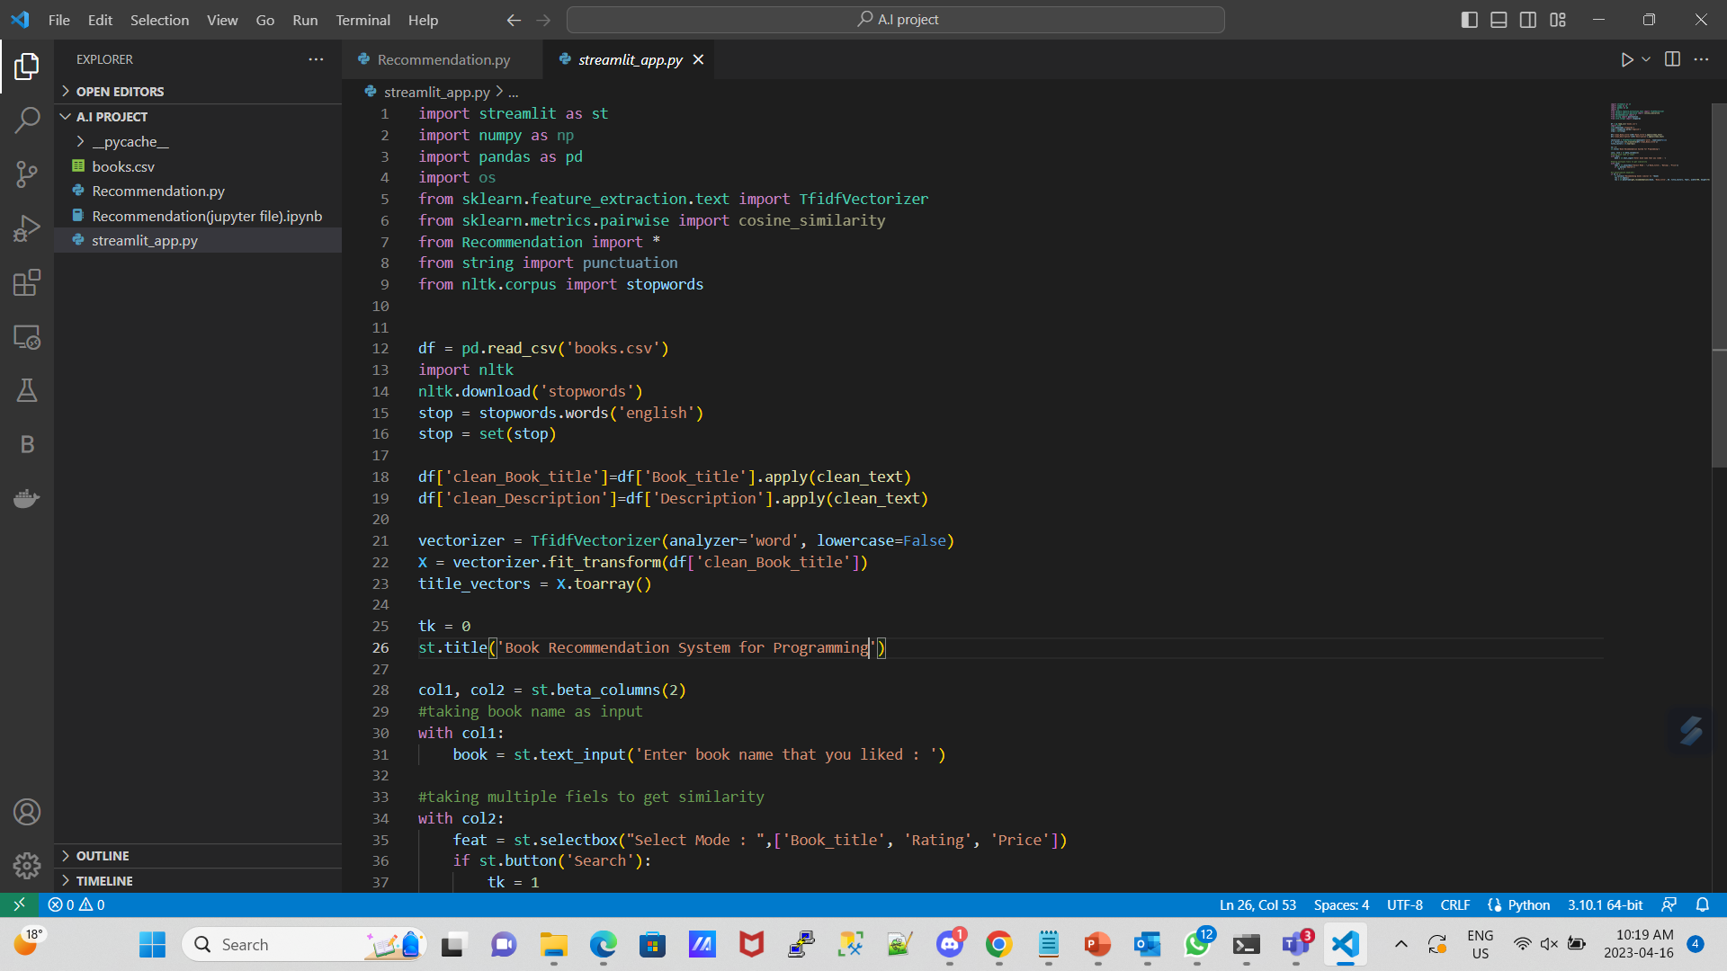
Recommendation engine
‘streamlit_app.py’ to make a user interface to search for books

Slide 48
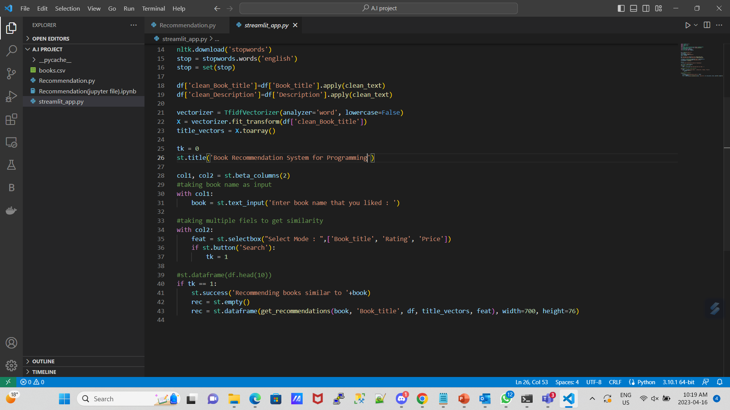
Recommendation engine

Slide 49
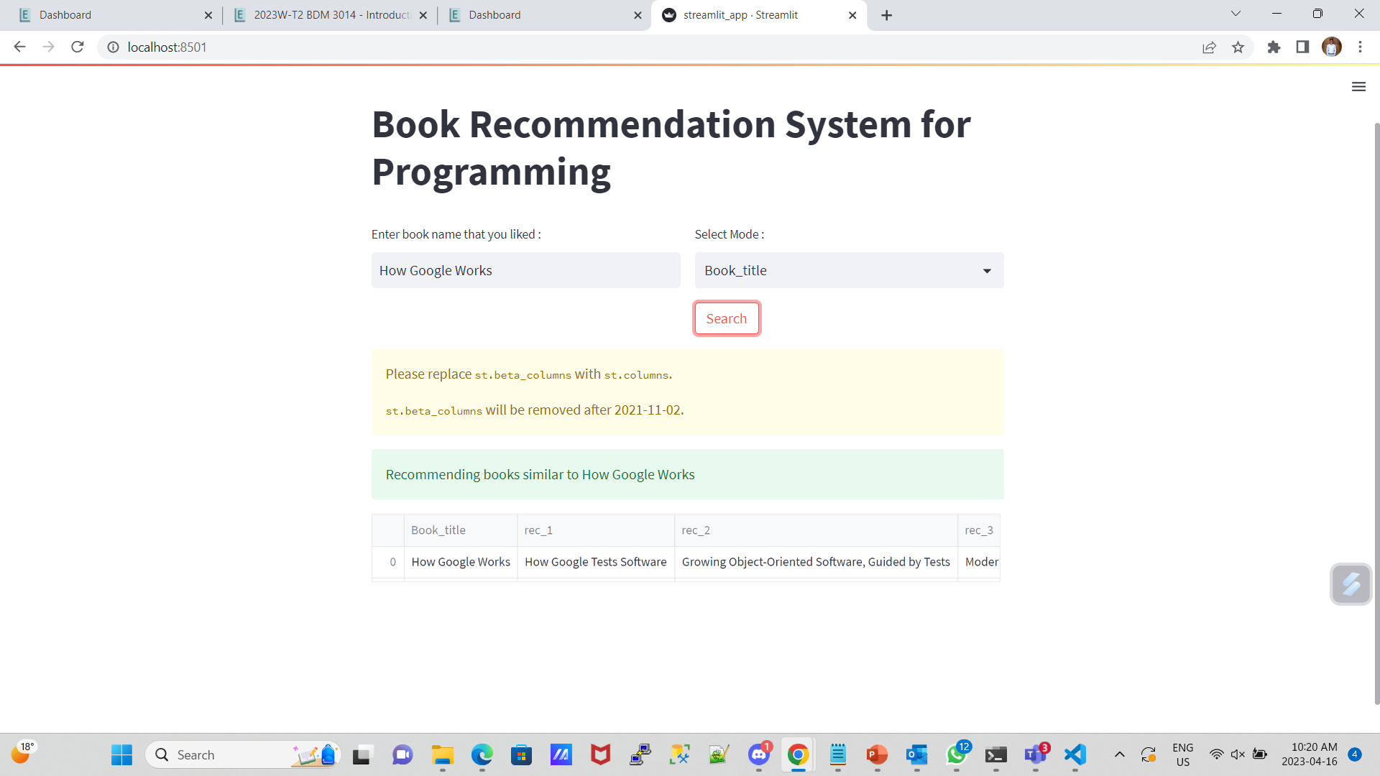
Recommendation engine
Screen shots of the output

Slide 50
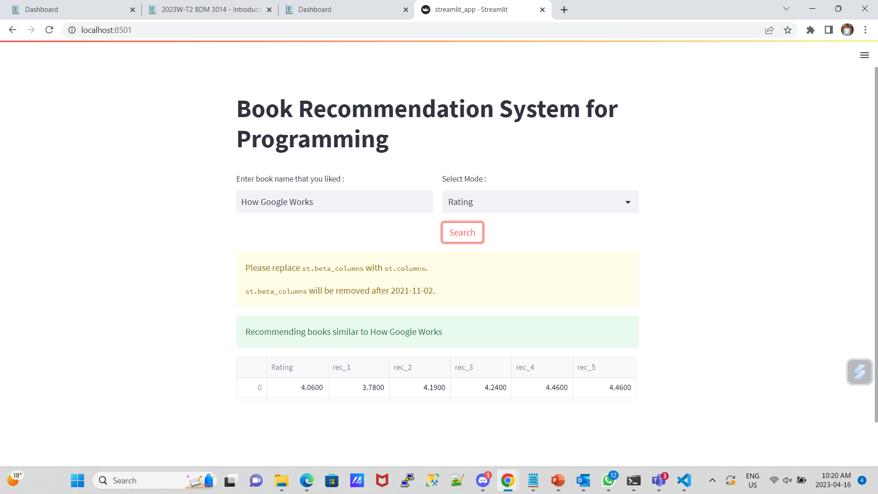
Recommendation engine

Slide 51
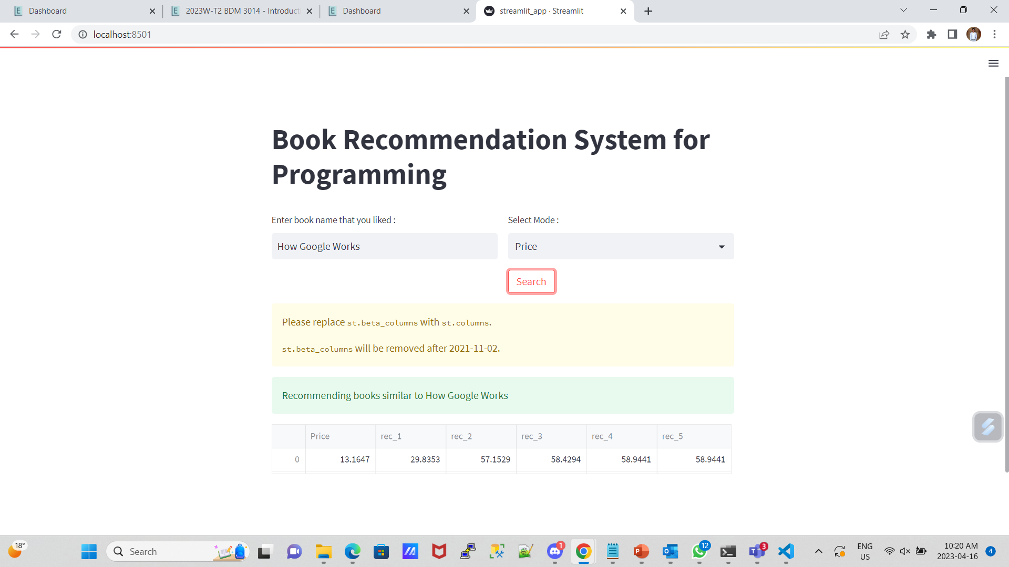
Recommendation engine

Slide 52
Conclusion
With the potential to increase sales, click-through rates, conversions, and even customer satisfaction, recommendation engines are a potent marketing tool.

Slide 53
References
Dataset: https://www.kaggle.com/datasets/thomaskonstantin/top-270-rated-computer-science-programing-books?select=prog_book.csv
Github: https://github.com/KelvinSimon09/RecommendationEngine
https://www.appier.com/en/blog/what-is-a-recommendation-engine-and-how-does-it-work#:~:text=A%20recommendation%20engine%20is%20a,be%20collected%20implicitly%20or%20explicitly.
https://www.analyticsvidhya.com/blog/2018/06/comprehensive-guide-recommendation-engine-python/
https://nafeea3000.medium.com/recommender-systems-c8db209dd0d3#:~:text=Content%20based%20Recommender%20System%3A&text=Given%20the%20user%2C%20we%20compute,using%20the%20Cosine%20Similarity%20technique.&text=We%20then%20pick%20the%20item,recommend%20those%20to%20the%20user.
https://cdn.analyticsvidhya.com/wp-content/uploads/2018/04/recommendation-system.png

